Slide 1
CS1102 DATA STRUCTURES AND ALGORITHMS
LAB 1
stevencao99@gmail.com

Slide 2
Sunfire & UNIX

Slide 3
MAJOR STEPS
Create and modify your program using Vim, emacs…
Compile and execute your program
Login to Sunfire machine
Please make sure that:
You have a sunfire account
(request at https://mysoc.nus.edu.sg/~newacc)
You have downloaded & installed SSH Secure Shell

Slide 4
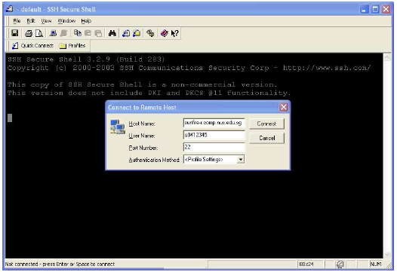
Logging in to Sunfire
Run your SSH Secure Shell Client
Host name: sunfire-r.comp.nus.edu.sg or sunfire.comp.nus.edu.sg
User name: Your Unix-Id (case-sensitivity)
Port number: 22
Password (in the next pop-up window): Your Unix password

Slide 5
Notes
Do not click the Close button on the top-right corner
Typing ‘q’ or ‘Ctrl-C’ to terminate a program
Do not press ‘Ctrl-Z’ (which sends a program to background). If you did, type ‘fg’ to bring it to the foreground and terminate it
If you pressed ‘Ctrl-S’/Scroll lock(which locks to screen), press ‘Ctrl-Q’/Scroll lock to unlock.
Use up, down arrow for command shortcut.
Use Tab for filename shortcut.
Type ‘passwd’ to change password (be careful)

Slide 6
Setting up your account & online help
Run the set-up program by typing
  ~cs1101c/lab0/setup
  After the set-up, type
  source .bash_profile
Use ‘man’ to access the Unix help facility
E.g.
man man
man ls

Slide 7
UNIX commands
Command | Modifier | Purpose | Example
pwd |  | Print current working directory | pwd
ls | -l, -F | List the files in current directory | ls ls –l ls –F
cd |  | Change the working directory to another | cd (to HOME directory) cd abc (to the abc directory under the current directory)
mkdir |  | Make a sub-directory in the current directory | mkdir abc (make the sub-directory abc)
rmdir |  | Remove a sub-directory in the current directory (the sub-directory must be empty) | rmdir abc

Slide 8
Unix commands (cont.)
Command | Purpose | Example
cp | Copy file | cp thisfile.txt another.txt
mv | Move a file, can be used for renaming a file | mv thisname.txt newname.txt
rm | Remove file (be careful) | rm afile.txt
less | View the content of a file on the screen (Space to move down, ‘b’ to move up) | less thisfile.txt
logout | Log out | logout

Slide 9
Using VIM
Vim is a text-editor on Unix platform
Type ‘vim hello.java’ to create the file hello.java or open it (if it already existed)
Press ‘i’ or ‘Esc’ to switch between Insert mode/Command mode
Press “<ESC>:x<Enter>” to save your program & quit (Note: not <ESC>:X<Enter>)
Press “<ESC>:w<Enter>” to save without quitting.
You can go to http://tnerual.eriogerg.free.fr/vim.html for more information

Slide 10
Compiling & running Java program
Compile your program
javac hello.java (Translate it to bytecode)
Run your program
java hello

Slide 11
CourseMarker

Slide 12
Starting the CourseMarker Client
1. Type this after you connect to sunfire:
/home/appn/cmarker/CM3_Client/cs1102text.sh
2. Input username and password according to the email sent to your NUSNET email account.

Slide 13
Hierarchy in CourseMarker System
System Level
lc
up
Course Level
lu
up
lx
Unit Level
exercise
up

Slide 14
At the Exercise Level, to download the relevant files from CourseMarker to your sunfire account, type set
(this command will overwrite any existing file in the exercise directory, so be careful!)
The downloaded files are stored at:
CMhome/cs1102/studentArea/[Your CourseMarkerId]/cs1102lab00ex1
To go back to your sunfire account, type quit

Slide 15
Submitting Your Program
Do not introduce additional .java file(s)
Do not change the file name given

Slide 16
Submitting Your Program
Start CourseMarker
Navigate to the correct exercise
Type submit
Check the report if you have scored well on Compilation Tool and All Dynamic Tests sections

Slide 17
Digital Root
Given n, we need to add up the digits of n. If the result has more than 1 digit, the process is repeated.
Probably have encountered this in CS1101/CS1101C

Slide 18
Digital Root
Straight forward: we add up all the digits.
Check if the result has 1 digit.
If not, repeat the process

Slide 19
Digital Digit
Pseudocode:
  While (n>9) do
      root = 0
      do
      root = root + n mod 10
      n = n / 10
      od while (n>0)
      n = root

Slide 20
Examples
278
  => root = 0 + 8 = 8 ; n = 27
  => root = 8 + 7 = 15 ; n=2
  => root = 15 + 2 = 17 ; n = 0
17
  => root = 0 + 7 = 7 ; n = 1
  => root = 7+1 = 8 ; n = 0

